Slide 1
Click Through Rate Prediction
Introduction
Aim: To predict the label whether a user will click on an ad (label 1) or not (label 0).
Data Description
EDA & Data Engineering
Classification Models (Baseline, bagging, boosting)
Smoting, resampling
Hyperparameter tuning
By Kamaljeet Singh, Maheedhar Kolli, Shrey Arora

Slide 2
Data Description
120,000 Observations with 35 features with output label 0 or 1
21 categorical variables
'uid', 'task_id','city', 'device_name', 'career', 'gender' etc. '
14 continuous variables
"Age","city_rank","device_size","his_app_size","his_on_shelf_time" etc
Class imbalance
0 115504 - 96.25%
1 4496 - 3.75%

Slide 3
EDA
Unique Categories
Chi-square test of association - Y and Categorical Input Variables
Correlation matrix and heat map for Continuous Variables
Data Cleaning/ Feature Engineering
Dummy variables
Reduce number of classes for categorical inputs
Communication_onlinerate (3^4^5^6^7^8^9^10^11^12^13^14^15^16^17^18^19^20)

Slide 4
Model Selection
Model | Precision | Recall | F1 score
Logistic Regression | 0.08 | 0.46 | 0.13
Decision Tree | 0.06 | 0.06 | 0.06
Random Forest | 0.02 | 0.48 | 0.03
XGBoost | 0.375 | 0.003 | 0.0059

Slide 5
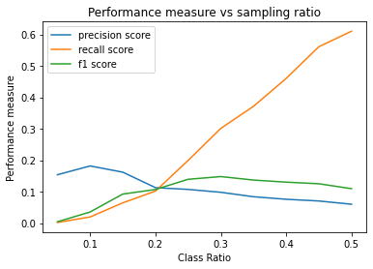
RESAMPLING
Undersample with different class ratios
Model | Precision | Recall | F1 score
Decision Tree | 0.046 | 0.55 | 0.09
Random Forest | 0.06 | 0.58 | 0.11
XGBoost | 0.06 | 0.62 | 0.13

Slide 6
RESAMPLING
Oversample with SMOTE
Synthetic Minority Oversampling Technique
*Presently working on hyper-parameter tuning for final models
Model | Precision | Recall | F1 score
Decision Tree | 0.07 | 0.08 | 0.07
Random Forest | 0.25 | 0.01 | 0.02
XGBoost | 0.05 | 0.01 | 0.03

